Slide 1
DataSpark: Illuminating Insights for Global Electronics
Done by: Sathiyan U C

Slide 2
Agenda
Introduction
Problem Statement
Steps
Tips
Conclusion

Slide 3

Introduction

Slide 4
Introduction to the company
Global Electronics, a leading retailer of consumer electronics, has provided you with several comprehensive datasets containing detailed information about their customers, products, sales, stores, and currency exchange rates.
The company seeks to leverage this rich data repository to gain deeper insights into their business operations, customer behavior, and market trends.

Slide 5

Problem Statement

Slide 6
Problem Statement & Use Cases
Problem Statement
As part of Global Electronics' data analytics team, you are tasked with conducting a comprehensive Exploratory Data Analysis (EDA) to uncover valuable insights from the company’s data.
Your goal is to provide actionable recommendations that can enhance customer satisfaction, optimize operations, and drive overall business growth.
Business Use Cases
By Analyzing Global Electronics' customer, product, sales, and store data will provide insights to enhance marketing strategies, optimize inventory management, and improve sales forecasting.
This will help tailor campaigns, develop better products, plan promotions, and decide store expansions. Understanding currency exchange rates will enable better international pricing strategies.

Slide 7
Steps
Involved in this project

Slide 8
Steps
Dataset Review
Data Preprocessing
Exploratory Data Analysis(EDA)
Importing data & creating queries in SQL
Data Visualization

Slide 9

Step 1: Dataset Review
Company has provided five datasets,
They are,
Customers Dataset
Products Dataset
Sales Dataset
Stores Dataset
Exchange Rates dataset

Slide 10
Dataset Review
Customers Dataset Review
There are 7748 male Consumers & 7518 female consumers are consuming products in Global Electronics.
US has the highest customers of around 6282 among all other countries.
Products Dataset Review
There are 2517 products available in Global Electronics with 11 brands and 16 color categories.
Sales Dataset Review
Total sales happened in Global Electronics are 62815.
Stores Dataset Review
Global Electronics having 67 stores in 7 countries and 1 online store.
US has the highest stores of around 24 stores.
Exchange Rates Dataset Review
As we know that Global Electronics is an MNC which handling around 7 countries with 6 exchange rates(currency code) namely:
USD(US Dollars)
EUR(Euro)
GBP(Pound Sterling UK)
CAD(Canadian Dollars)
AUD(Australian Dollars)

Slide 11

Step 2: Data Preprocessing
Steps involved in data preprocessing are,
Data Collection
Data Cleaning
Data Integration
Data Transformation
Data Reduction
Data Splitting
Handling Imbalanced Data
Data Validation

Slide 12
Step 3: Exploratory Data Analysis
Exploratory Data Analysis (EDA) is an approach to analyzing data sets to summarize their main characteristics, often using statistical graphics and other data visualization methods. It is used to:
Understand the data: Gain insights into the data's distribution, central tendency, and variability.
Identify patterns and relationships: Discover trends, correlations, and outliers.
Formulate hypotheses: Generate testable hypotheses for further analysis.
Clean and prepare data: Identify and handle missing values, outliers, and inconsistencies.

Slide 13
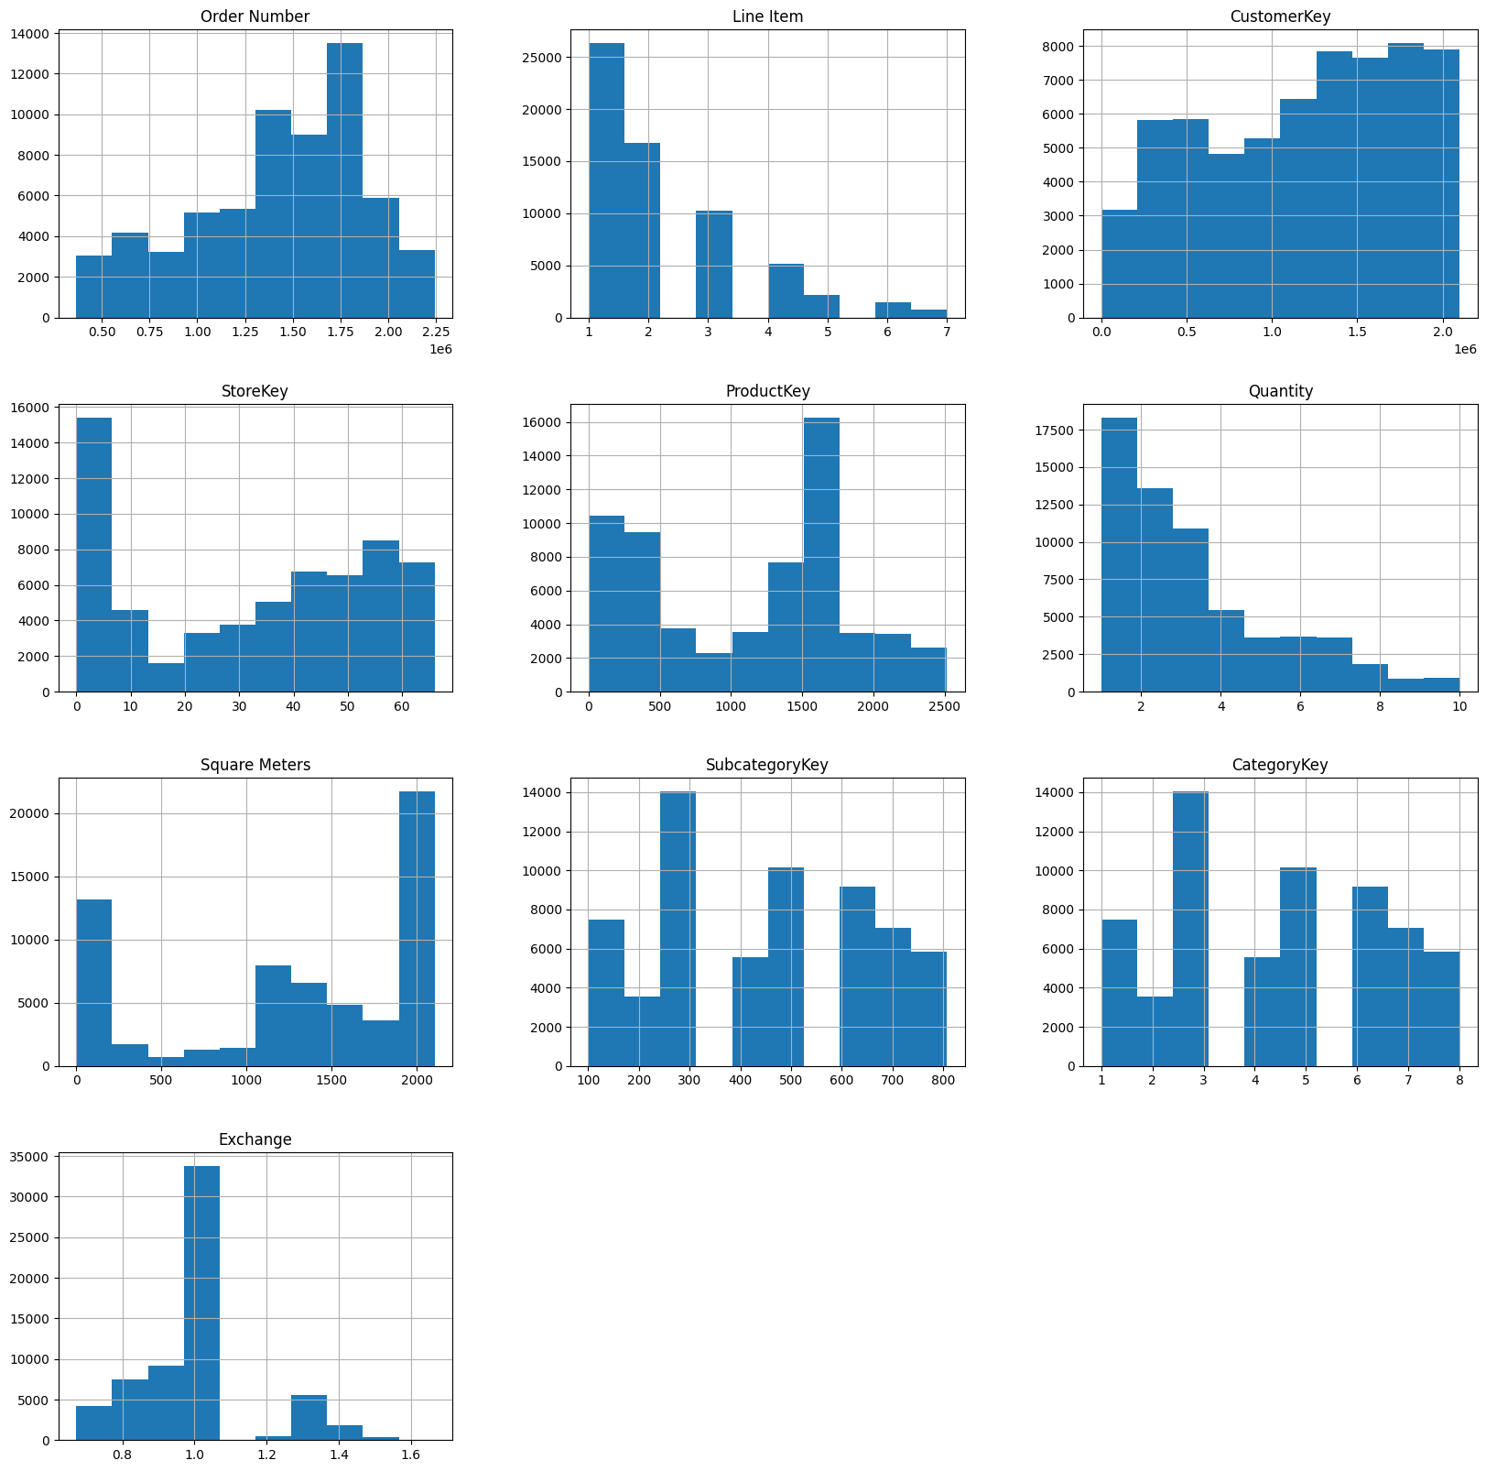
Exploratory Data Analysis(EDA)
Through EDA I have gained some Insights. They are:
From StoreKey Outliers it’s clear that majority of customers prefer to purchase products online otherwise, they are typically dispersed.
Line item is a right skewed distribution, well it’s indicating that some line items from range of 1 to 3 are well liked by customers.
Quantity distribution contains 2 to 3 most orders whether it is right skewed, most amounts are modest.
Product key shows variance with certain products having more counts than others.
Square meters based on bimodal distribution with two distribution peaks.

Slide 14
Step 4: Importing Data into SQL and Writing Queries in SQL
Steps involved in this:
Importing preprocessed data.
Insert the preprocessed data into an SQL database by creating relevant tables for each data source and using SQL INSERT statements to load the data.
Writing SQL queries.
To extract key insights from the data. These queries should address important business questions and support the analysis steps below.

Slide 15

Data Visualization using Power BI
Data visualization transforms complex data into meaningful visuals like charts and graphs. It helps to:
Understand trends and patterns: Easily identify trends, outliers, and relationships within the data.
Communicate insights effectively: Clearly convey complex information to audiences of all levels.
Make data-driven decisions: Support informed decision-making by providing a clear and concise overview of the data.
Engage and inspire: Make data more interesting and engaging for audiences.

Slide 16
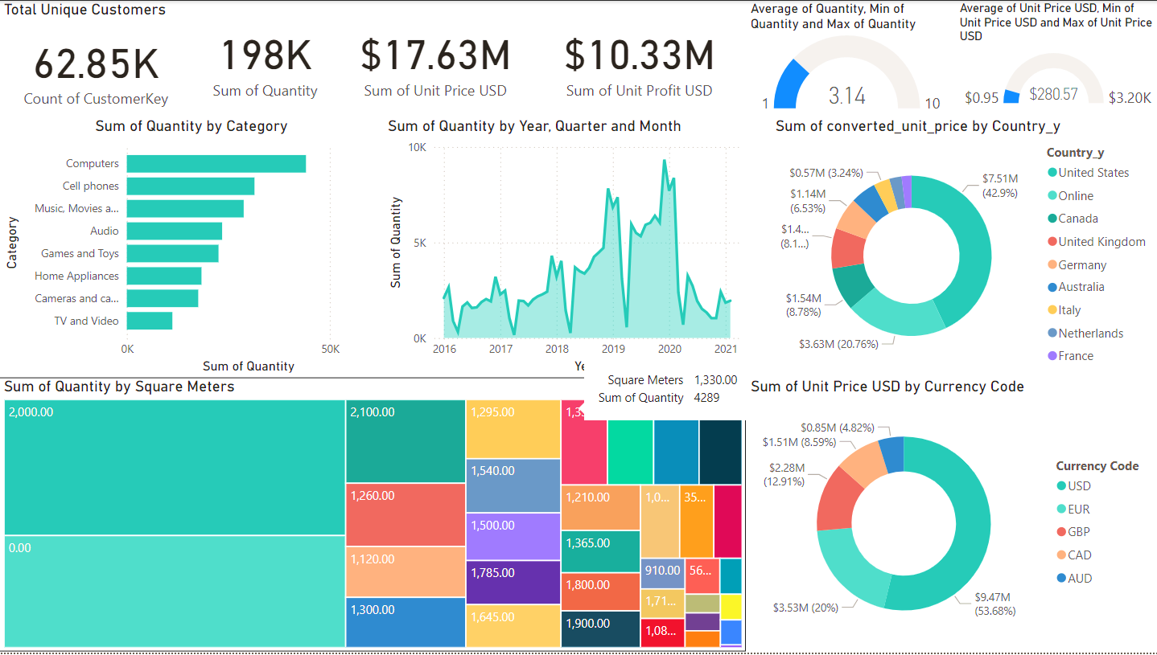
Dashboard
This dashboard provides a comprehensive overview of sales and customer metrics for a global electronics business.
Key insights include the total number of unique customers, sales quantity, unit price, and profit in USD. It breaks down sales quantity by product categories, years, and months, showing trends over time.
Additionally, the dashboard highlights country-wise sales contributions, currency-wise revenue distribution, and the correlation of quantity with square meters.
The visualization enables stakeholders to identify top-performing categories, regions, and pricing patterns.

Slide 17
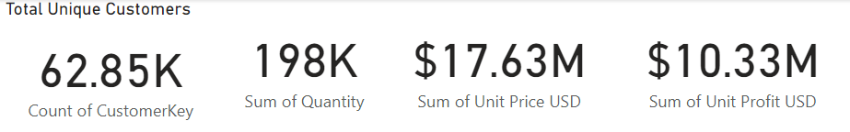
Dashboard Insights
There are 62815 consumers consuming products from Global Electronics
Total Profit of Global Electronics is about $10.33 Million(₹ 880,095,340).
Totally 198k & above products sold in Global Electronics
Total Revenue of Global Electronics is about $17.63 Million(₹1,502,040,740).

Slide 18
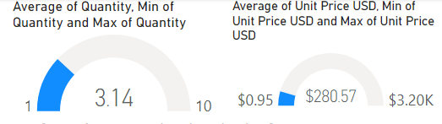
Dashboard Insights
Average product sold in Global Electronics is 3.14 with minimum of 1 and maximum of 10 products.
Average Revenue of Global Electronics is $280.57 with minimum of $0.95 and maximum of $3.20k.

Slide 19
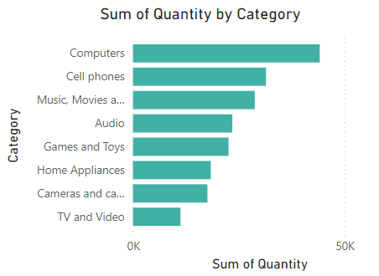
Dashboard Insights
Total Product sold by each category:
Computers(44k), Cell Phones(37k), Music, Movies & Audiobooks(29k), Audio(23k), Games & Toys(23k), Home Appliances(18k), Cameras & Camcorders(18k), TV & Video(11k).
This visual clearly indicates that computers are the most sold products, highlighting customers' strong preference for technology.
TV & Video are the least sold products, indicating a decline in demand among customers.

Slide 20
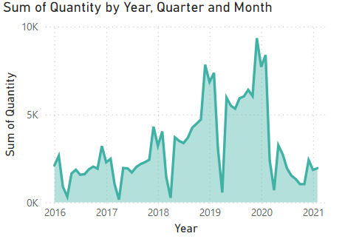
Dashboard Insights
Total sales by month, quarter & year:
In the initial stage, only 2,101 products were sold in January of the 1st quarter of 2016.
By the end, only 1,949 products were sold in February of the 1st quarter of 2021, which is even lower than the sales in the starting year, 2016.
The highest number of products sold was 9,343 in December of the 4th quarter of 2019, marking the peak sales period.

Slide 21
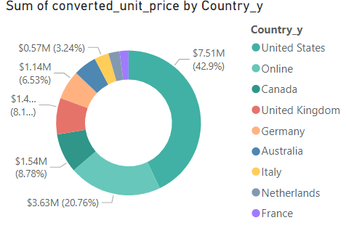
Dashboard Insights
Total sales by each country:
This visual shows that the US generates the highest revenue among all countries, totaling $7.51 million and accounting for approximately 42.9% of the total revenue, followed by Online sales and Canada.
France has the least revenue, totaling $347K and contributing approximately 1.99% of the total revenue.
So, the United States is the highest profit maker for Global Electronics.

Slide 22
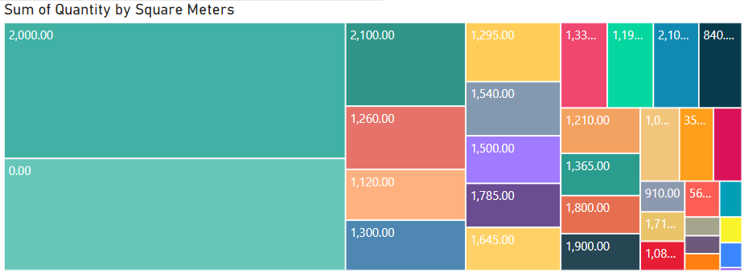
Dashboard Insights
Total sales by store size:
The highest sales occurred in the US, with a store size of 2,000 square meters, followed by online sales (0.00) and the UK (2,100 square meters).
The least sales occurred in Australia, with a store size of 665 square meters.

Slide 23
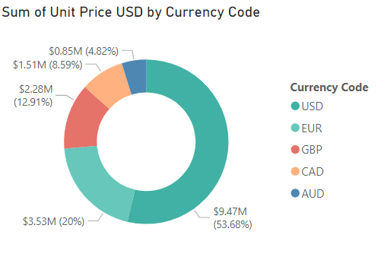
Dashboard Insights
Total revenue by currency code:
This visual provides information about which currency code generates the highest revenue among all.
The highest revenue was generated by the USD currency, amounting to $9.46 million.
The lowest revenue was generated by the AUD currency, amounting to 1.36 million AUD, which is equivalent to $849k..

Slide 24
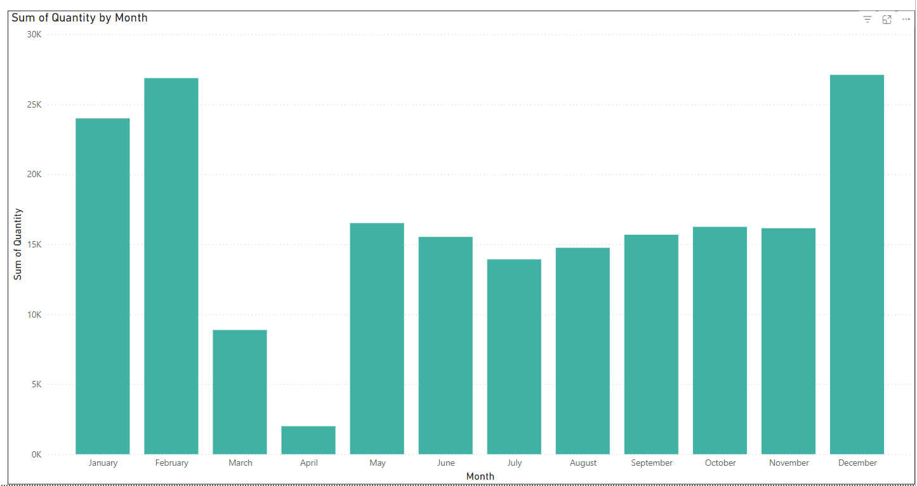
Dashboard Insights
Total sales by each month:
This visual provides monthly income insights for Global Electronics across all years.
December is the month with the highest sales among all months, indicating that consumers prefer making purchases during the winter season.
April has the least sales, likely due to it being a transitional month between seasons, with consumers waiting for new products.

Slide 25
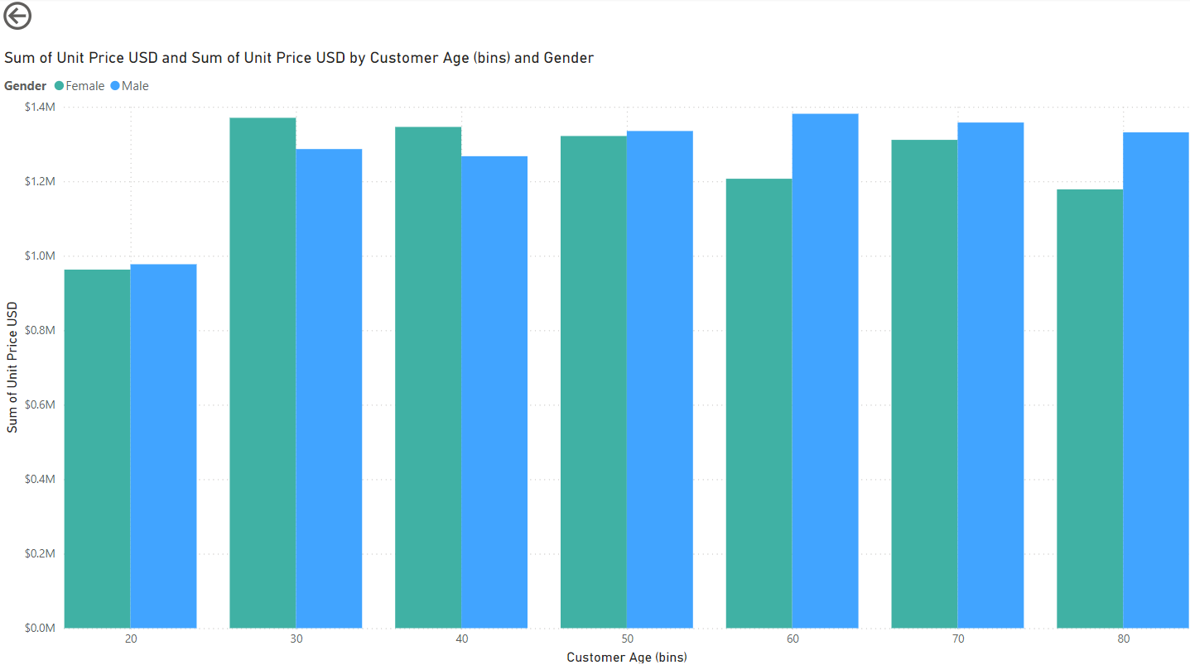
Dashboard Insights
Total revenue generated by customer Age & Genders:
This visual shows the total revenue generated by each customer age group, broken down by gender.
The 30 age group has the highest revenue among all, with males generating $1.28M and females generating $1.37M, totaling $2.65M.
The least revenue comes from the 20 age group, with males generating $977k and females generating $962k, totaling $1.92M.

Slide 26
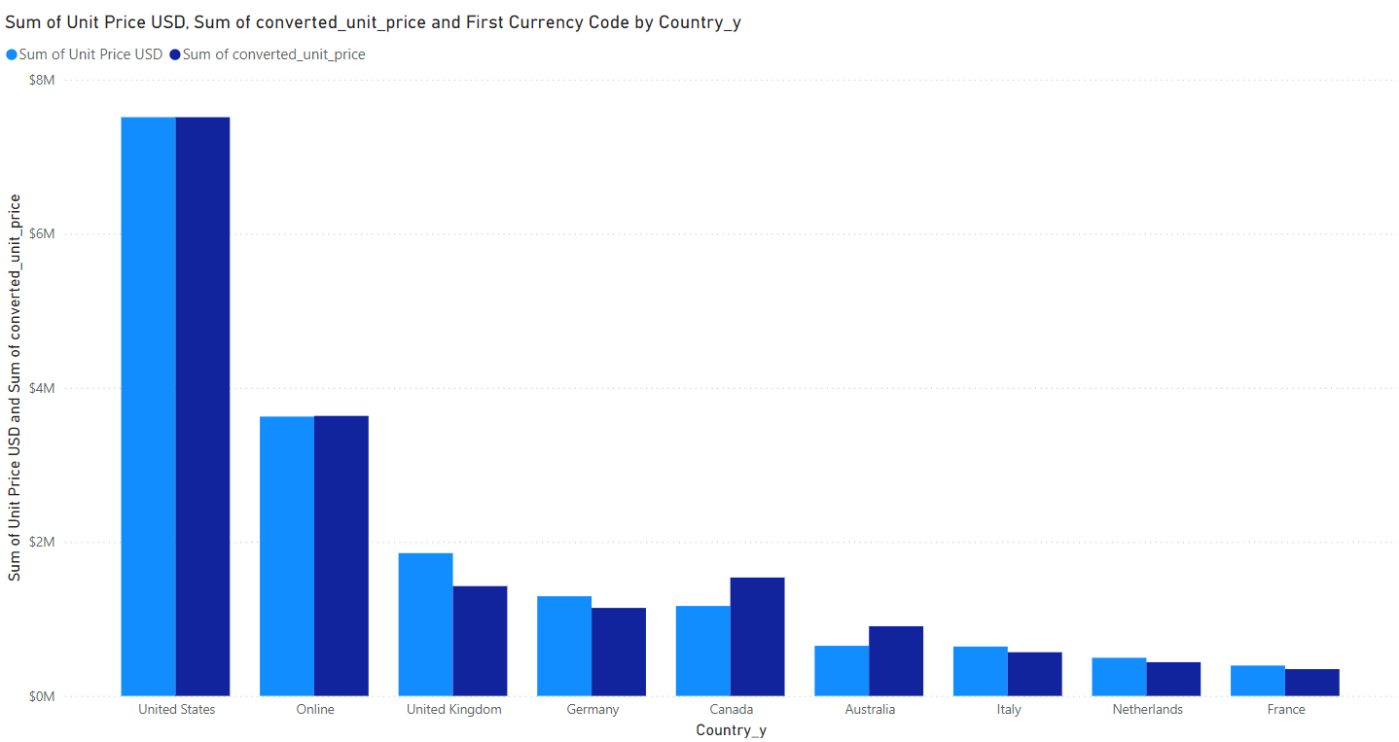
Dashboard Insights
Total converted revenue by each Country:
This visual shows the total revenue and total converted revenue for each country.
The US has the highest revenue in both total and converted, with $7.51M.
France has the least revenue, with a total of $394k and total converted revenue of $347k.

Slide 27
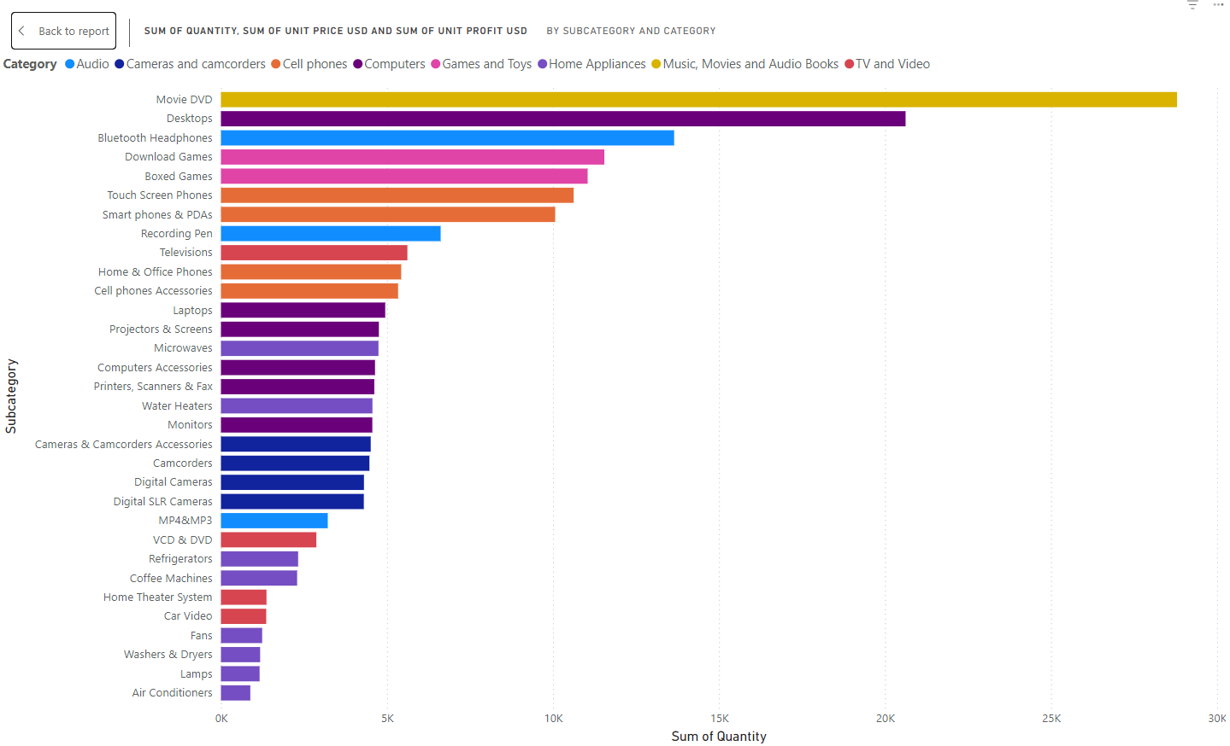
Dashboard Insights
Sales by each sub category:
This visual shows the total revenue and total profit for each subcategory under the category.
The top subcategory is Movie DVD under the Music, Movie & Audiobooks category, with a total revenue of $988k and total profit of $603k.
The least-performing subcategory is Home Theatre under the TV & Audio category, with a total revenue of $224k and total profit of $124k.

Slide 28
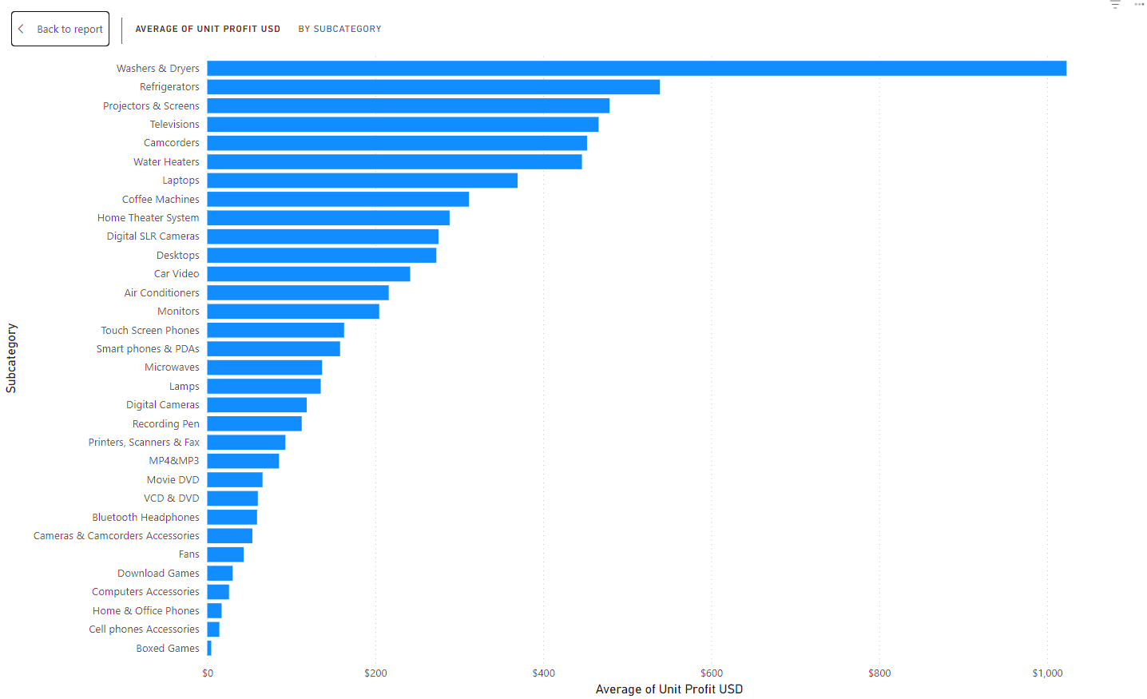
Dashboard Insights
Average profit by each sub category:
This visual illustrates the average profit generated by each subcategory.
Washers & Dryers represent the subcategory with the highest average revenue, amounting to $1,810.26.
The least profitable subcategory is Boxed Games, with an average revenue of $8.34, likely due to the growing popularity of digital gaming platforms, which has significantly reduced the demand for physical game copies.

Slide 29
Tips to increase sales & market growth
Global Electronics can boost sales and market growth by embracing innovation and adapting to market trends.
This involves continuously improving products, understanding consumer behavior, investing in digital tools, using data-driven decision making, being agile in operations, and forming strategic alliances.
By staying ahead of trends, companies can capitalize on opportunities and mitigate risks.
By staying innovative and responsive, companies can foster long-term growth and gain a competitive edge in the marketplace.

Slide 30
Conclusion
Most customers prefer online purchases because of the convenience, wider product selection, ability to compare prices, and the ease of shopping from home without the need to visit physical stores.
The US has the highest sales due to factors such as a large consumer base, strong purchasing power, well-developed infrastructure, and a high demand for diverse products across various sectors.
To increase sales and market growth, companies can focus on strategies such as expanding product offerings, enhancing customer experience, leveraging digital marketing, optimizing pricing strategies, building strong brand loyalty, and entering new markets or segments. Additionally, embracing innovation and adapting to market trends can drive sustained growth.

Slide 31
Thank you
Sathiyan U C
sathiyanuc@gmail.com
LinkedIn
GitHub

